Slide 1
UNIT-IV

Slide 2
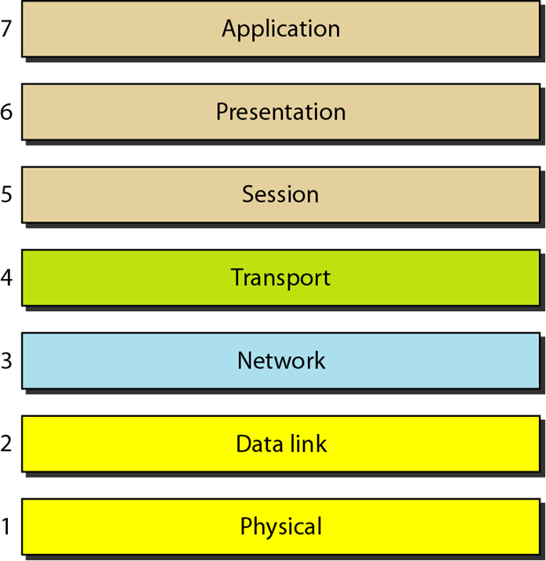
Reference model- OSI

Slide 3
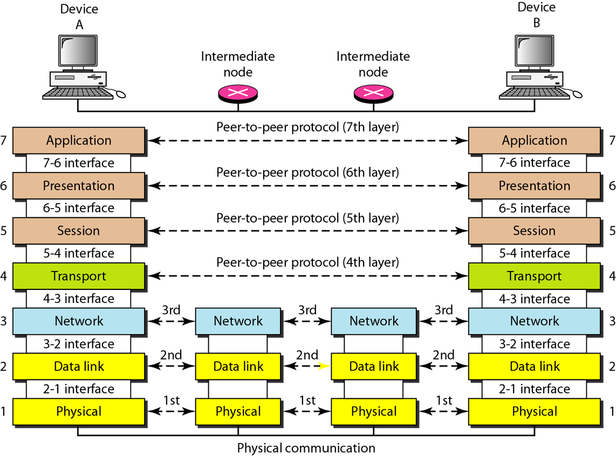
Interfaces b/w Layers

Slide 4
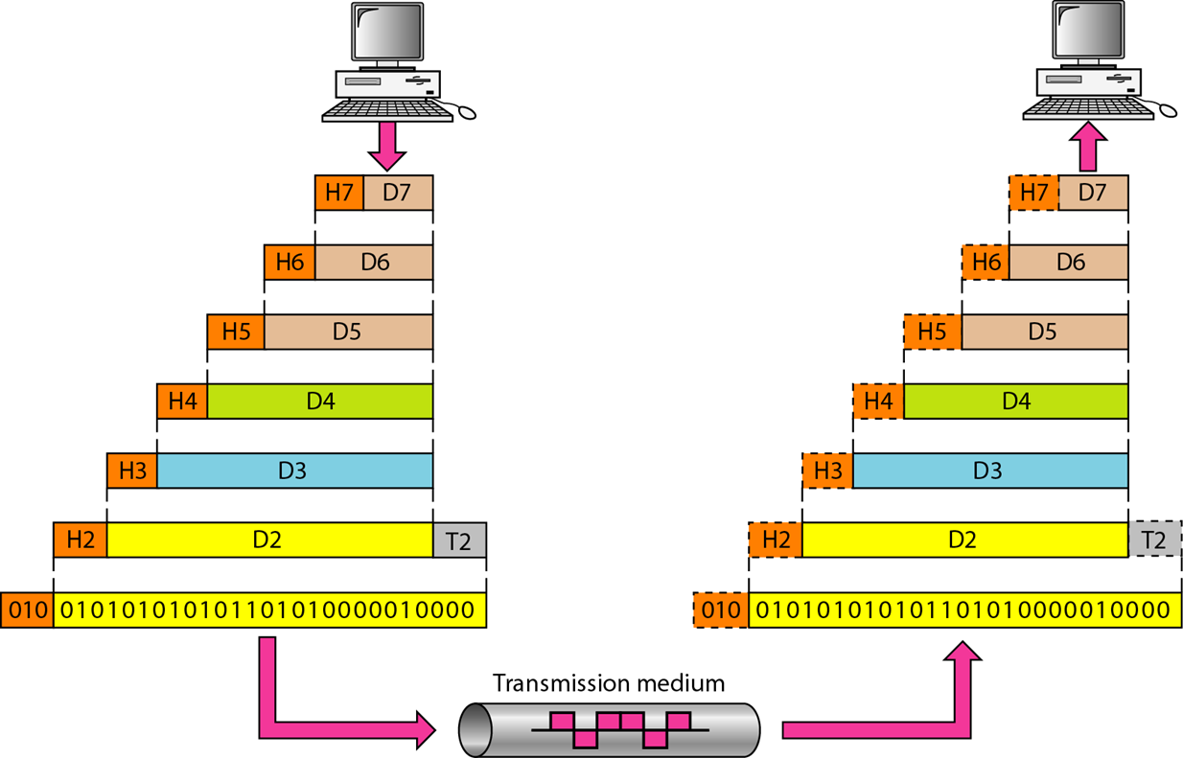
Exchange using the OSI Model

Slide 5
Physical Layer
The physical layer is responsible for movements of individual bits from one hop (node) to the next.
Physical characteristics of interface and medium: pin assignment, connector, cables
Representation of bits: encoding
Data rate
Synchronization of bits
Line configuration: point-to-point, multipoint
Physical topology
Transmission mode: simplex, half-duplex, full-duplex

Slide 6
Data Link Layer
The data link layer is responsible for moving frames from one hop (node) to the next.
Framing
Physical addressing
Flow control
Error control
Access control

Slide 7
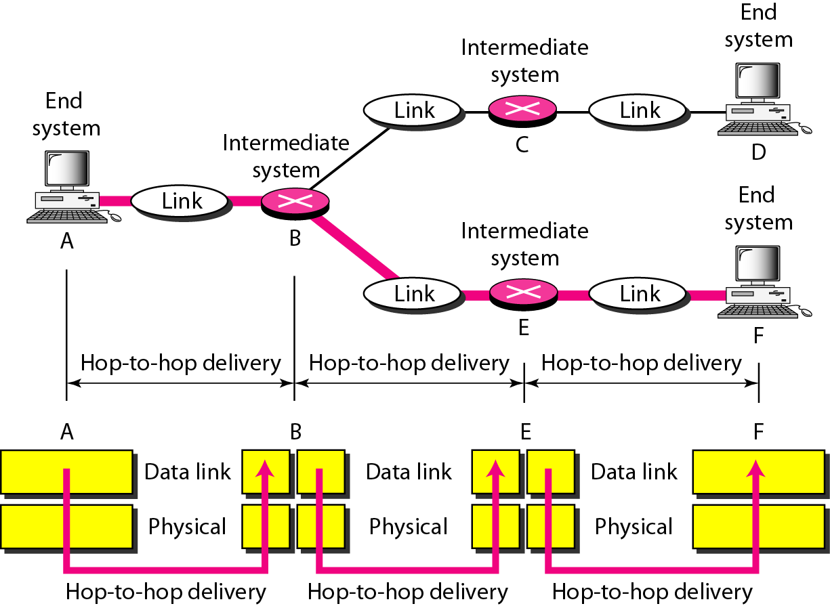
Hop-to-hop Delivery

Slide 8
Network Layer
The network layer is responsible for the delivery of individual packets from the source host to the destination host.
Logical addressing
Routing

Slide 9
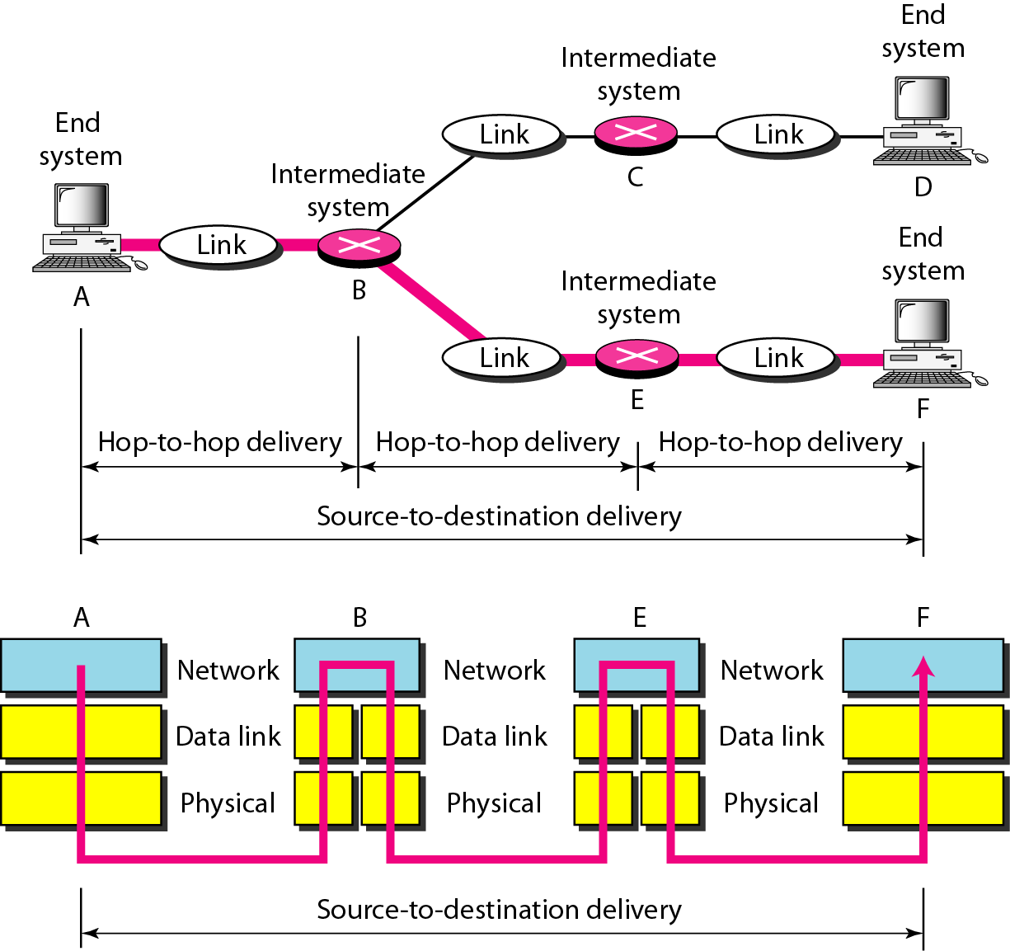
Source-to-destination delivery

Slide 10
Transport layer
The transport layer is responsible for the delivery of a message from one process to another.
Service-point addressing
Segmentation and reassembly
Connection control
Flow control
Error control

Slide 11
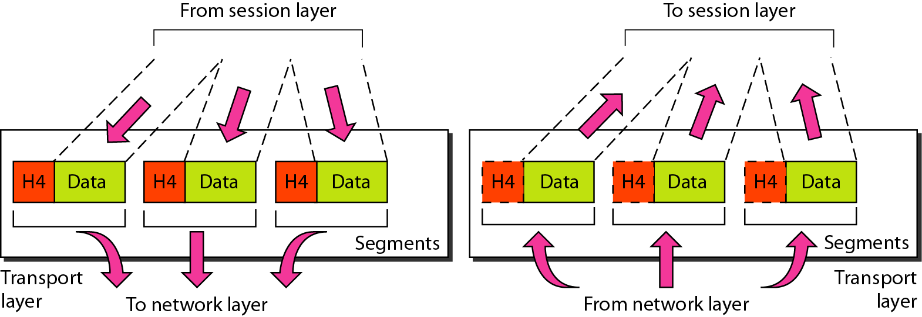
Segmentation and Reassembly

Slide 12
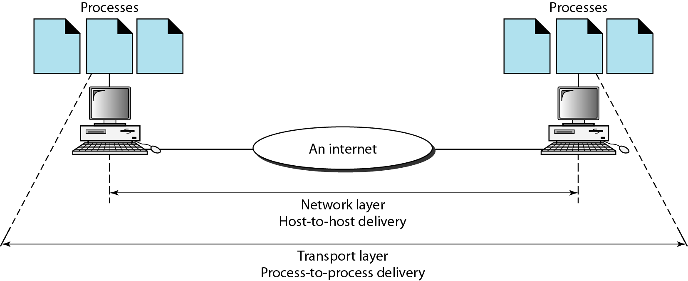
Reliable process-to-process delivery of a message

Slide 13
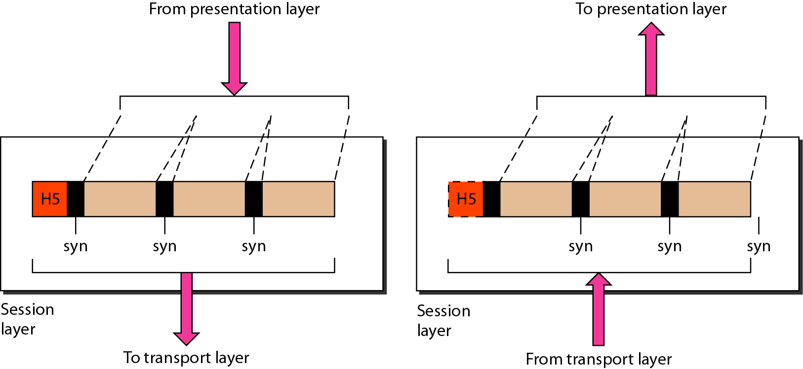
Session layer
The session layer is responsible for dialog control and synchronization.

Slide 14
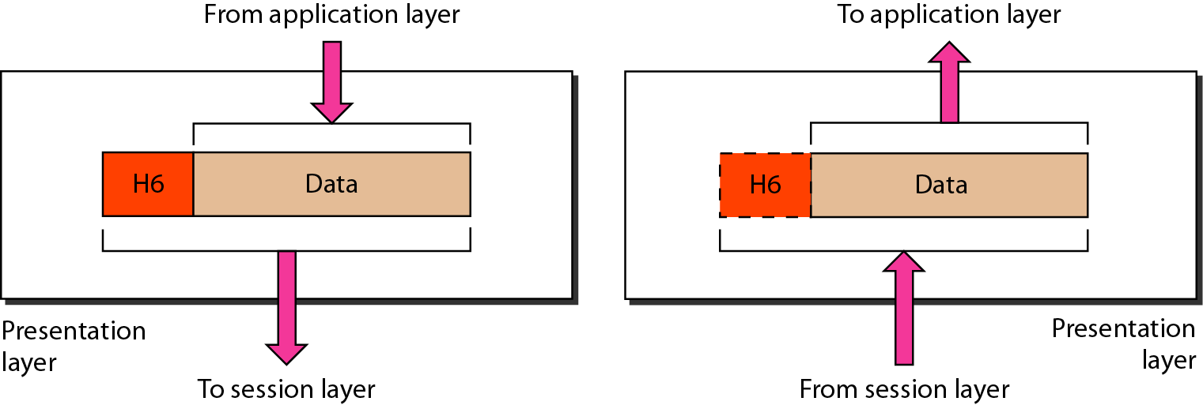
Presentation layer
The presentation layer is responsible for translation, compression, and encryption.

Slide 15
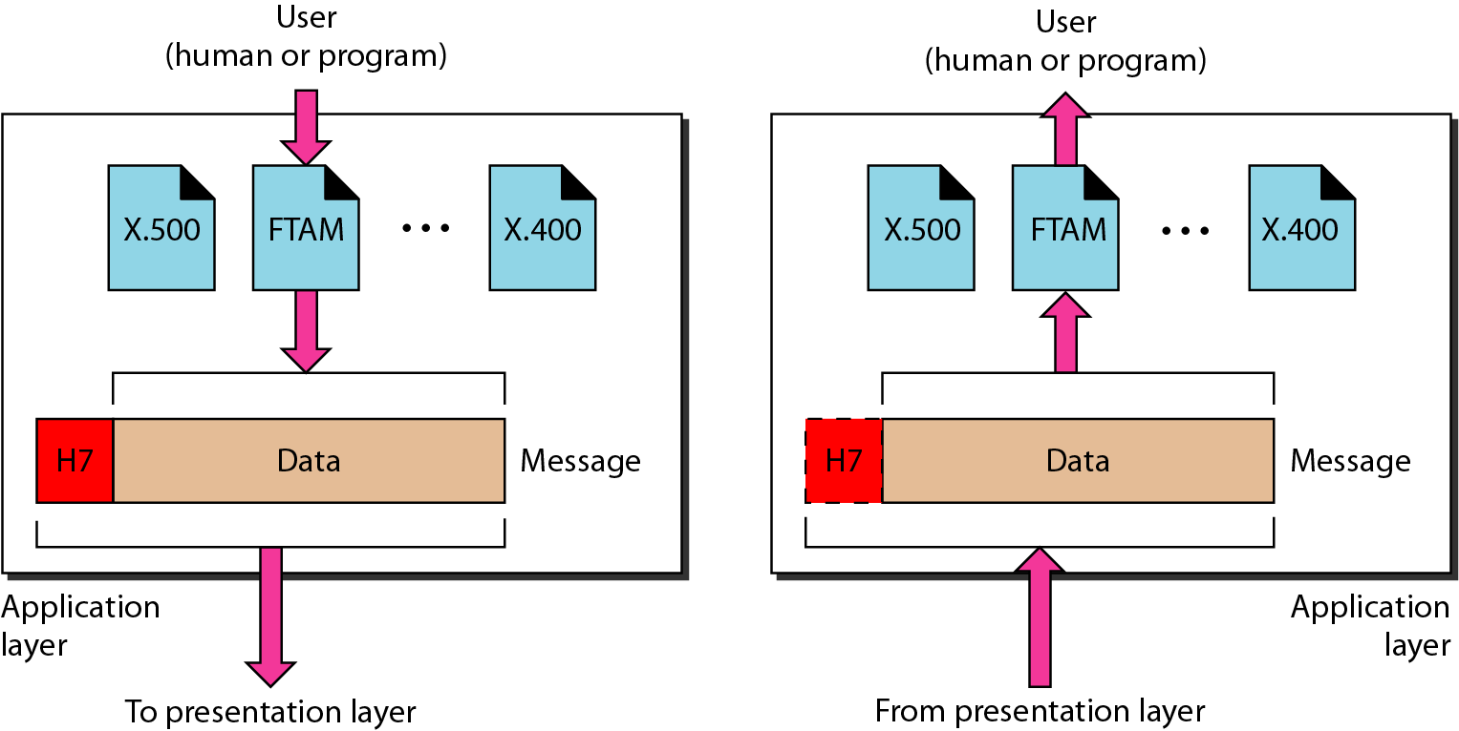
Application layer
The application layer is responsible for providing services to the user.

Slide 16
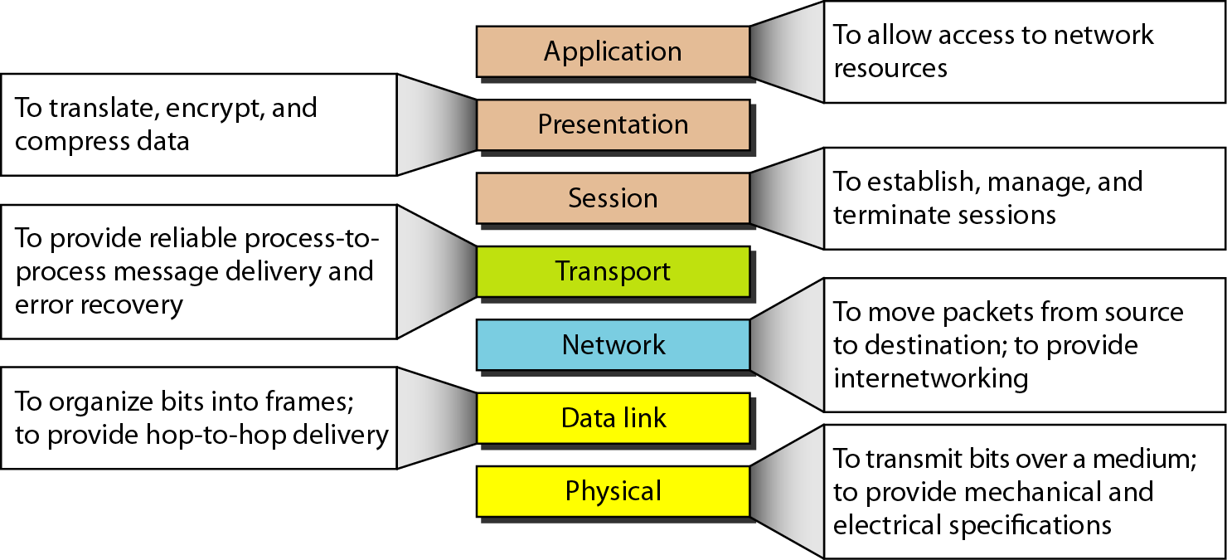
Summary of layers

Slide 17
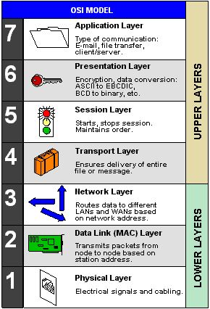

Slide 18
TCP/IP PROTOCOL SUITE
The layers in the TCP/IP protocol suite do not exactly match those in the OSI model.
The original TCP/IP protocol suite was defined as having four layers: host-to-network, internet, transport, and application.
However, when TCP/IP is compared to OSI, we can say that the TCP/IP protocol suite is made of five layers: physical, data link, network, transport, and application.

Slide 19
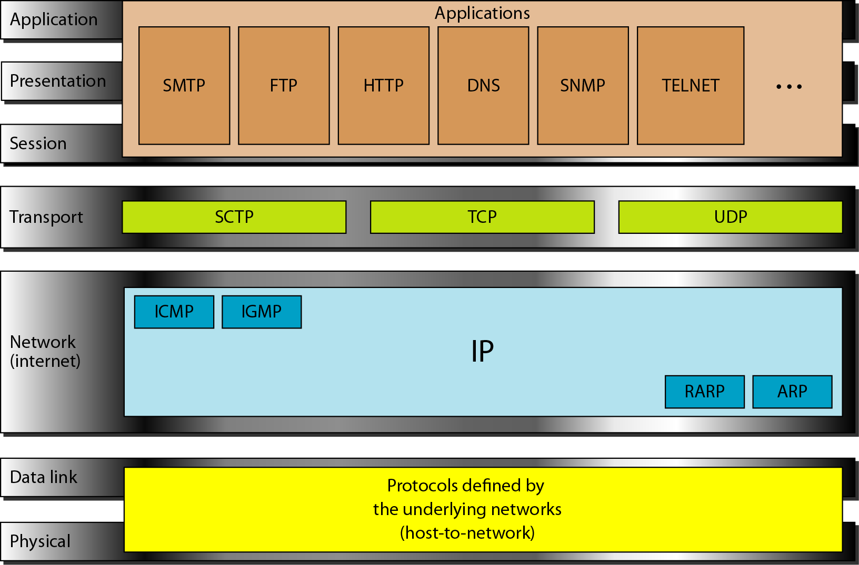
TCP/IP and OSI model

Slide 20
ADDRESSING
Four levels of addresses are used in an internet employing the TCP/IP protocols:
Physical address
Ex. Ehternet address, machine address
Logical address
IP address
Port number
Specific
URL, Email address, domain name

Slide 21
Network layer in TCP/IP
Address resolution
Reverse address resolution
Internet control message
Internet group message

Slide 22
Transport layer in TCP/IP
User Datagram Protocol (UDP)
Connectionless, unreliable
Transmission Control Protocol (TCP)
Connection-oriented, reliable
Stream Control Transmission Protocol (SCTP)
For supporting multimedia and VOIP

Slide 23
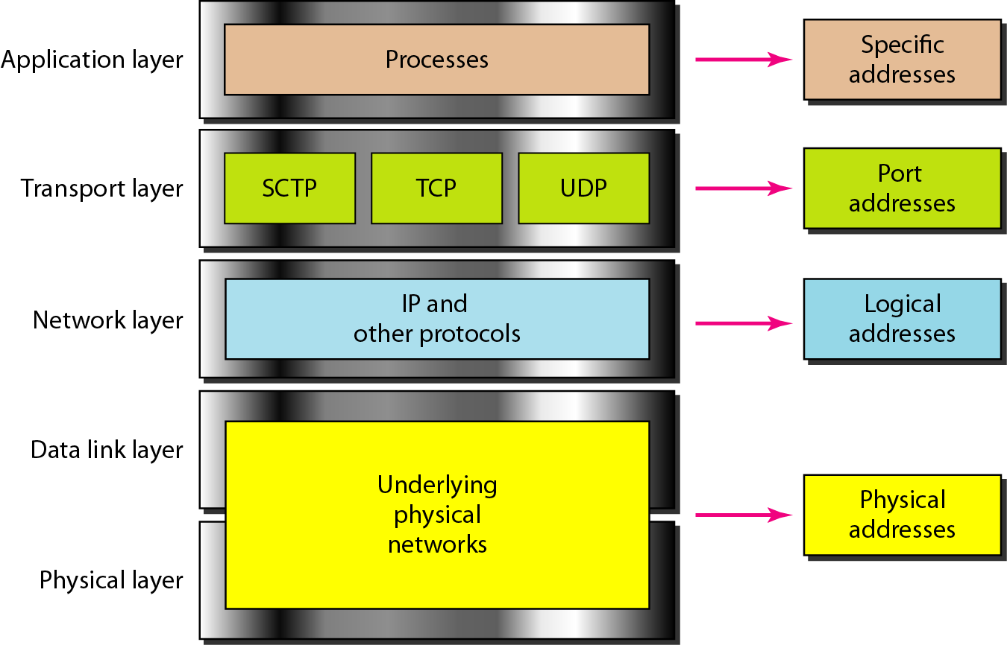
Relationship of layers and addresses in TCP/IP

Slide 24
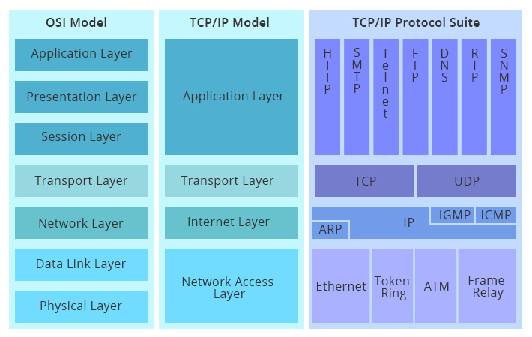

Slide 25
critiques of OSI and TCP/IP model
Neither the OSI model and its protocols nor the TCP/IP model and its protocols are perfect. The criticism of the OSI model and its protocols can be summarized as:
1. Bad timing.
2. Bad technology.
3. Bad implementations.
4. Bad politics.

Slide 26
Bad timing
The competing TCP/IP protocols were already in widespread use by research universities by the time the OSI protocols appeared.
While the billion-dollar wave of investment had not yet hit, the academic market was large enough that many vendors had begun cautiously offering TCP/IP products.
When OSI came around, they did not want to support a second protocol stack until they were forced to, so there were no initial offerings.
With every company waiting for every other company to go first, no company went first and OSI never happened.

Slide 27
Bad Technology
The second reason that OSI never caught on is that both the model and the protocols are flawed. The choice of seven layers was more political than technical, and two of the layers (session and presentation) are nearly empty, whereas two other ones (data link and network) are overfull.
The OSI model, along with its associated service definitions and protocols, is extraordinarily complex. They are also difficult to implement and inefficient in operation.
In addition to being incomprehensible, another problem with OSI is that some functions, such as addressing, flow control, and error control, reappear again and again in each layer.

Slide 28
Bad Implementations
Given the enormous complexity of the model and the protocols, it will come as no surprise that the initial implementations were huge, unwieldy, and slow. It did not take long for people to associate "OSI" with "poor quality". Although the products improved in the course of time, the image stuck.
In contrast, one of the first implementations of TCP/IP was part of Berkeley UNIX and was quite good. People began using it quickly, which led to a large user community, which led to improvements, which led to an even larger community. Here the spiral was upward instead of downward.

Slide 29
Bad Politics
On account of the initial implementation, many people, especially in academia, thought of TCP/IP as part of UNIX, and UNIX in the 1980s in academia was not unlike parenthood and apple pie.
OSI, on the other hand, was widely thought to be the creature of the European telecommunication ministries. The very idea of a bunch of government bureaucrats trying to shove a technically inferior standard down the throats of the poor researchers and programmers down in the trenches actually developing computer networks did not aid OSI's cause.

Slide 30
The TCP/IP model and protocols have their problems too.
First, the model does not clearly distinguish the concepts of services, interfaces, and protocols.
Good software engineering practice requires differentiating between the specification and the implementation, something that OSI does very carefully, but TCP/IP does not.
Consequently, the TCP/IP model is not much of a guide for designing new networks using new technologies.

Slide 31
Second, the TCP/IP model is not at all general and is poorly suited to describing any protocol stack other than TCP/IP.
Trying to use the TCP/IP model to describe Bluetooth, for example, is completely impossible.

Slide 32
Third, the link layer is not really a layer at all in the normal sense of the term as used in the context of layered protocols.
It is an interface (between the network and data link layers).
The distinction between an interface and layer is crucial and one should not be sloppy about it.

Slide 33
Fourth, the TCP/IP model does not distinguish between the physical and data link layers.
These are completely different.
The physical layer has to do with the transmission characteristics of copper wire, fiber optics, and wireless communication.
The data link layer's job is to delimit the start and end of frames and get them from one side to the other with the desired degree of reliability.
A proper model should include both as separate layers.
The TCP/IP model does not do this.

Slide 34
Use of Computer Networks.
The computer networks are playing an important role in providing services to large organization as well as to the individual common man.
Many organizations have a large number of computers in operation. These computers may be within the same building, campus, city or different cities.
• Even though the computers are located in different locations, the organizations want to keep track of inventories, monitor productivity, do the ordering and billing etc.
• The computer networks are useful to the organizations in the following ways:
1. Resource sharing.
2. For providing high reliability.
3. To save money.
4. It can provide a powerful communication medium.

Slide 35
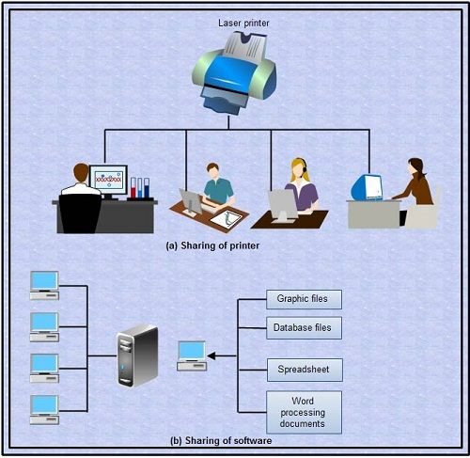
Resource sharing
It allows all programs, equipment's and data available to anyone on the network irrespective of the physical location of the resource and the user.

Slide 36
High reliability due to alternative sources of data
It provides high reliability by having alternative sources of data. For e.g. all files could be replicated on more than one machines, so if one of them is unavailable due to hardware failure or any other reason, the other copies can be used.
• The aspect of high reliability is very important for military, banking, air traffic control, nuclear reactor safety and many other applications where continuous operations is a must even if there are hardware or software failures.

Slide 37
Money saving
Computer networking is an important financial aspect for organizations because it saves money.
• Organizations can use separate personal computer one per user instead of using mainframe computer which are expensive.
• The organizations can use the workgroup model (peer to peer) in which all the PCs are networked together and each one can have the access to the other for communicating or sharing purpose.
• The organization, if it wants security for its operation it can go in for the domain model in which there is a server and clients. All the clients can communicate and access data through the server.
• The whole arrangement is called as client -server model.

Slide 38
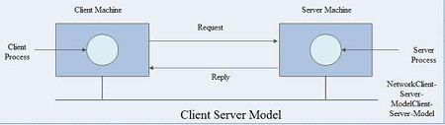

Slide 39
Client: The individual workstations in the network are called as clients.
Server
The central computer which is more powerful than the clients and which allows the clients to access its software and database is called as the server .
• Server computers typically are more powerful than client computers or are optimized to function as servers.

Slide 40
Communication medium
A computer network provides a powerful communication medium among widely separated employees.
• Using network it is easy for two or more employees, who are separated by geographical locations to work on a report, document or R and D simultaneously i.e. on -line.

Slide 41
Networks for People:
Starting in 1990s, the computer networks began to start delivering services to the private individuals at home.
• The computer networks offer the following services to an individual person:
1. Access to remote information
2. Person to person communication
3. Interactive entertainment.

Slide 42
Access to remote information
Access to remote information involves interaction· between a person and a remote database. Access to remote information comes in many forms like:
(i) Home shopping, paying telephone, electricity bills, e-banking, on line share market etc.
(ii) Newspaper is. On-line and is personalized, digital library consisting of books, magazines, scientific journals etc.
(iii) World wide web which contains information. about the arts, business, cooking, government, health, history, hobbies, recreation, science, sports etc.

Slide 43
Person to person communication
Person to person communication includes:
(i) Electronic-mail (e-mail)
(ii) Real time e-mail i.e. video conferencing allows remote users to communicate with no delay by seeing and hearing each other. Video-conferencing is being used for remote school, getting medical opinion from distant specialists etc.
(iii) Worldwide newsgroups in which one person posts a message and all other subscribers to the newsgroup can read it or give their feedbacks.

Slide 44
Interactive entertainment
Interactive entertainment includes:
(i) Multiperson real-time simulation games.
(ii) Video on demand.
(iii) Participation in live TV programmes likes quiz, contest, discussions etc.
In short, the ability to merge information, communication and entertainment will surely give rise to a massive new industry based on computer networking.

Slide 45
ISP and their classes
The ISP, short for 'Internet Service Provider', is the company that connects your personal computer, notebook, netbook, PDA, mobile device, game station, etc. to the Internet. Another name for ISP is IAP, or Internet Access Provider.
In India, there are 3 categories of ISP license authorizations under the Unified License to become an internet service provider, depending upon scale or the City/State/Town/District/Village you want to start your ISP business in.

Slide 46
The 3 categories are differentiated by the scale of the territory/coverage area of the ISP license i.e. whether the License is for (i) national area, (ii) major states / metro cities or (iii) other smaller cities, towns, villages and districts.

Slide 47
Class A (National Area) – This license is for Pan India operations.
Class B (Telecom Circle/Metro Area) – Class B license is issued for a total of 20 major states or any of the following Metro Cities – Mumbai, New Delhi, Kolkata, Chennai, Bengaluru, Pune, Hyderabad and Ahmedabad.
The govt keeps issuing notifications regarding territories declared as telecom circles and metro areas from time to time.
Class C (Secondary Switching Area) – This license is for only a particular secondary switching area. A secondary switching area is a government defined territory which could comprise of several small villages, towns or even districts. A class C license holder will have access to any 1 particular SSA only, unless he applies for multiple authorizations under one unified License.

Slide 48
Architecture of Internet
Network architecture is the design of a communication network. It is a framework for the specification of a network's physical components and their functional organization and configuration, its operational principles and procedures, as well as data formats use. In telecommunication, the specification of a network architecture may also include a detailed description of products and services delivered via a communications network, as well as detailed rate and billing structures under which services are compensated.
The network architecture of the Internet is predominantly expressed by its use of the Internet Protocol Suite, rather than a specific model for interconnecting networks or nodes in the network, or the usage of specific types of hardware links.

Slide 49
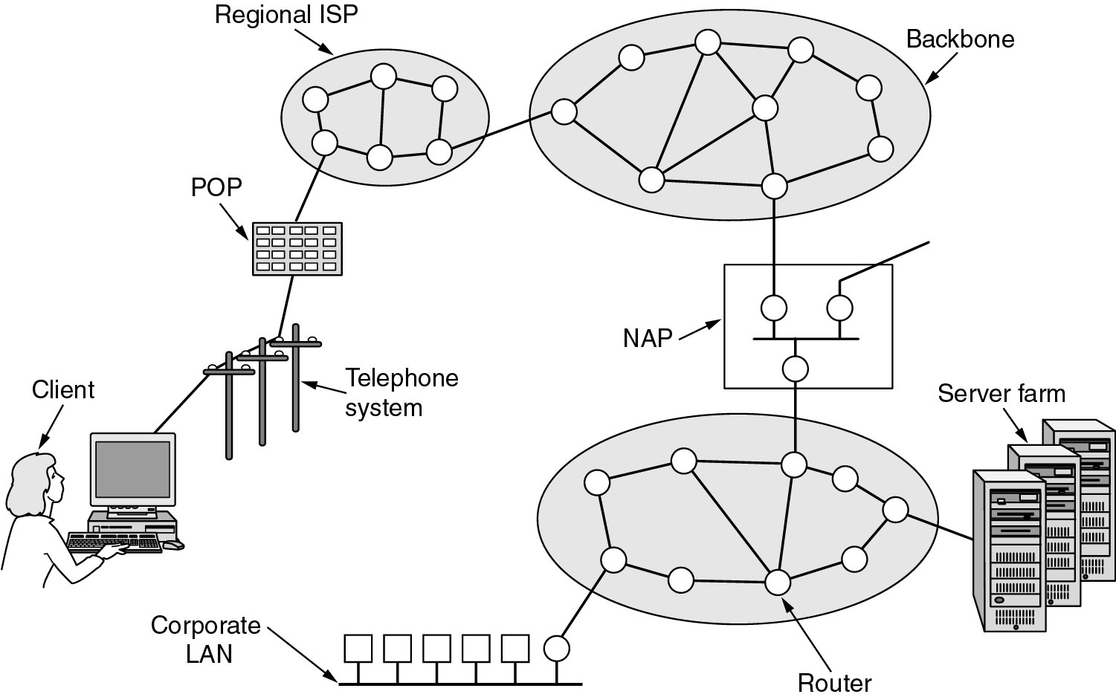

Slide 50
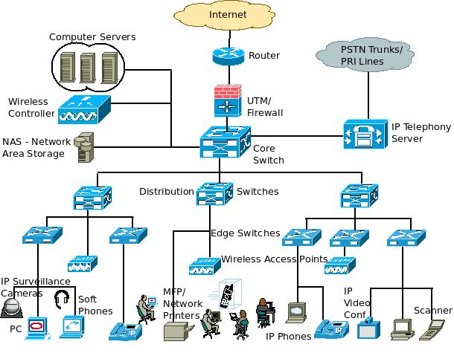

Slide 51
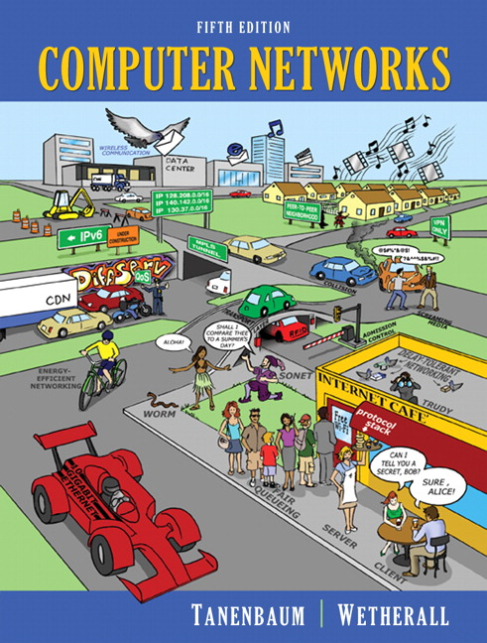

Slide 52
Networking Components
1. LIU
2. Media-Converter
3. RACK
4. HUB
5. Switch
6. Repeater
Wireless Access Point

Slide 53
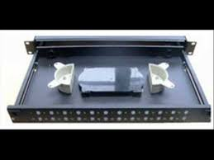
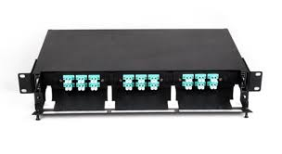
LIU

Slide 54
Light interface units are extensively used for wired communication networks. The LIUs are used for routing, terminating and managing optical cable terminations. These light interface units can be wall mounted or rack mounted for ease of use. The outer body is made of high quality steel with anti corrosive powder coating. Some of its specifications are as follows:
Usha-CT Fiber Patch panel is recessed unit
Has 19" mountings and 1U height
Available in 12 & 24 port with internal cable spools
Suitable for SC/LC adapters
Dimensions: 440mm x 200mm x 40mm
Thickness: 1.2mm

Slide 55
MEDIA-CONVERTER
A fiber media converter is a simple networking device that makes it possible to connect two dissimilar media types such as twisted pair with fiber optic cabling.
They were introduced to the industry in the 1990s, and are important in interconnecting fiber optic cabling-based systems with existing copper-based, structured cabling systems.
They are also used in metropolitan area network (MAN) access and data transport services to enterprise customers.

Slide 56
Fiber media converters can connect different local area network (LAN) media, modifying duplex and speed settings.
Switching media converters can connect different speed network segments. For example, existing half-duplex hubs can be connected to 100BASE-TX Fast Ethernet network segments over 100BASE-FX fiber.
Managed converters are usually of the switching kind and can additionally be managed by a network connection or a local console. However, most often pluggable transceivers are used instead when appropriate equipment already exists.

Slide 57
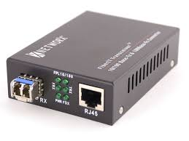
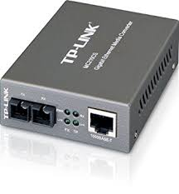
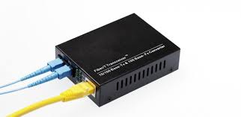

Slide 58
RACK
A rack unit (abbreviated U or RU) is a unit of measure defined as 44.50 millimetres (1.75 in).
It is most frequently used as a measurement of the overall height of 19-inch and 23-inch rack frames, as well as the height of equipment that mounts in these frames, whereby the height of the frame or equipment is expressed as multiples of rack units.
For example, a typical full-size rack cage is 42U high, while equipment is typically 1U, 2U, 3U, or 4U high.

Slide 59
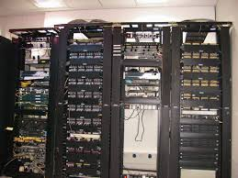

Slide 60
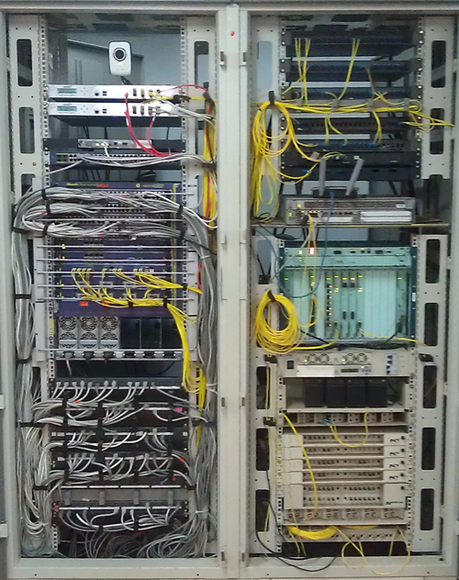

Slide 61
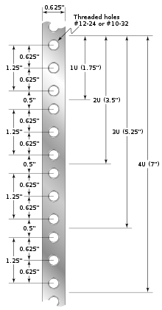

Slide 62
HUB
A hub, also called a network hub, is a common connection point for devices in a network. Hubs are devices commonly used to connect segments of a LAN.
The hub contains multiple ports. When a packetarrives at one port, it is copied to the other ports so that all segments of the LAN can see all packets.
Hubs and switches serve as a central connection for all of your network equipment and handles a data type known as frames.
Frames carry your data. When a frame is received, it is amplified and then transmitted on to the port of the destination PC.

Slide 63
In a hub, a frame is passed along or "broadcast" to every one of its ports.
It doesn't matter that the frame is only destined for one port.
The hub has no way of distinguishing which port a frame should be sent to. Passing it along to every port ensures that it will reach its intended destination. This places a lot of traffic on the network and can lead to poor network response times.
An Ethernet hub, active hub, network hub, repeater hub, multiport repeater, or simply hub is a network hardwaredevice for connecting multiple Ethernet devices together and making them act as a single network segment.
It has multiple input/output (I/O) ports, in which a signal introduced at the input of any port appears at the output of every port except the original incoming.
A hub works at the physical layer (layer 1) of the OSI model.
A repeater hub also participates in collision detection, forwarding a jam signal to all ports if it detects a collision. In addition to standard 8P8C("RJ45") ports, some hubs may also come with a BNC or an Attachment Unit Interface (AUI) connector to allow connection to legacy 10BASE2 or 10BASE5 network segments.

Slide 64
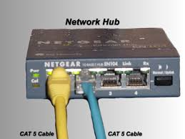
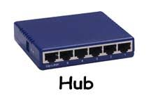

Slide 65
Layer 2 switching uses the media access control address (MAC address) from the host's network interface cards (NICs) to decide where to forward frames.
Layer 2 switching is hardware-based, which means switches use application-specific integrated circuit (ASICs) to build and maintain filter tables (also known as MAC address tables or CAM tables). One way to think of a layer 2 switch is as multiport bridge.
Layer 2 switching provides the following
Hardware-based bridging (MAC)
Wire speed / non-blocking forwarding
Low latency

Slide 66
Bridged networks break up collision domains, but the network remains one large broadcast domain.
Similarly, layer 2 switches (bridges) cannot break up broadcast domains, which can cause performance issues and limits the size of your network.
Broadcast and multicasts, along with the slow convergence of spanning tree, can cause major problems as the network grows.
Because of these problems, layer 2 switches cannot completely replace routers in the internet work.

Slide 67
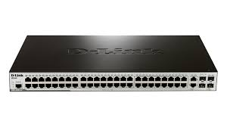
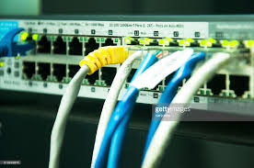

Slide 68
WIRELESS ACCESS POINT
In computer networking, a wireless access point (WAP), or more generally just access point (AP), is a networking hardware device that allows a Wi-Fi device to connect to a wired network.
The AP usually connects to a router (via a wired network) as a standalone device, but it can also be an integral component of the router itself.
An AP is differentiated from a hotspot, which is the physical location where Wi-Fi access to a WLAN is available.

Slide 69
An AP connects directly to a wired local area network, typically Ethernet, and the AP then provides wireless connections using wireless LAN technology, typically Wi-Fi, for other devices to utilize that wired connection.
APs support the connection of multiple wireless devices through their one wired connection.
Wi-Fi at 5 GHz goes only half as far as Wi-Fi at 2.4 GHz.

Slide 70
Types of Computer Network
Computer network can be classified according to their geographical area and their uses. Depending upon the geographical area covered by a network, it is classified as:
Local area network(LAN)
Wide area network(WAN)
Personal area network(PAN)
Metropolitan area network(MAN)
Campus Area Network (CAN)
Home Area Network(HAN)
Wireless Local Area Network (WLAN)

Slide 72
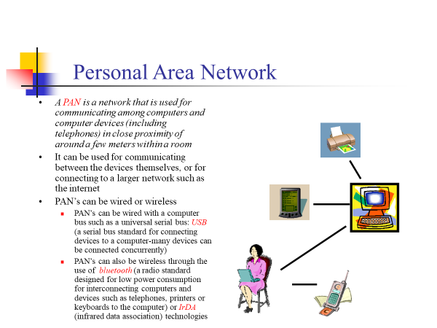
PAN, LAN, WAN, GAN classification

Slide 73
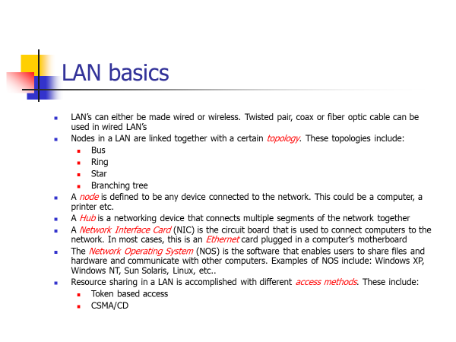

Slide 74
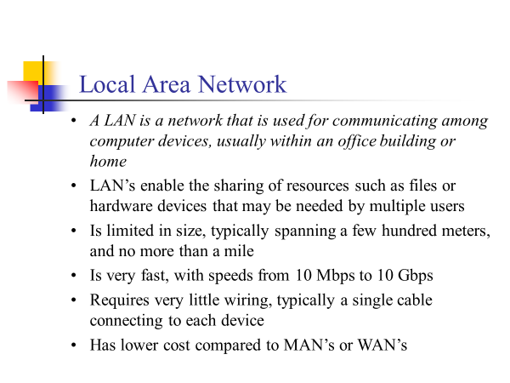

Slide 75
Characteristics of a LAN include:
Limited geographic operation up to 10 Km
High speed data transfer rates
Full time connectivity to local services
Generally lower in cost than a WAN
It uses mainly bus, ring and star topology
LAN support a variety of transmission medium such as Ethernet ,fiber, wireless etc
Requires little wiring, typically a single cable connecting to each device

Slide 76
Advantages and Disadvantages of LAN
Advantages
Lower in cost
Sharing of Resources
High Speed
Security
Disadvantages
When number of nodes became increases then performance became decrease.
Area covered is limited.

Slide 77
Advantages and Disadvantages of WAN
Advantages
large geographical area
Disadvantages
Complicated and complex
High cost
Required high performance devices
low security
WANs use very expensive network equipment.

Slide 78
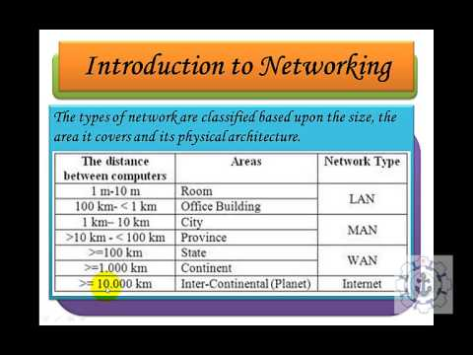

Slide 79
Key factors in evolution of Data Communication.

Slide 80
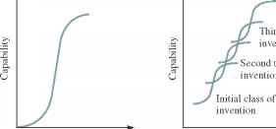
Role of Technology
no signal can propagate faster than the speed of light, and hence there is a minimum delay or latency in the transfer of a message between two points a certain distance apart.

Slide 81
Role of Regulation
telephone service is now considered an essential "lifeline" service in many countries, and regulation plays a role in ensuring that access to a minimal level of service is available to everybody. Regulation can also play a role in addressing the issue of which information should be available to people over a communications network.
Should encryption be so secure that no one, not even the government in matters of national security, can decipher transmitted information? These questions are not easily answered. The point here is that regulation on these matters will provide a framework that determines what types of services and networks can be implemented.

Slide 82
Role of the Market
consider the deployment of cellular radio telephony.
The service, first introduced in the late 1970s, was initially deployed as a high-end service that would appeal to a relatively narrow segment of people who had to communicate while on the move.
This deployment successfully established the initial market. The utility of being able to communicate while on the move had such broad appeal that the service mushroomed over a very short period of time.
The explosive growth in the number of cellular telephone subscribers prompted the deployment of new wireless technologies.

Slide 83
Role of Standards
many communication standards, especially for telephony, are developed by the International Telecommunications Union (ITU), which is an organization that operates under the auspices of the United Nations.
Almost every country has its own corresponding organization that is charged with the task of setting national communication standards. In addition, some standards are set by nongovernmental organizations.
The TCP/IP protocol suite and the Ethernet local area network are two examples of this type of standard.3 De facto standards arise when a certain product, or class of products, becomes dominant in a market.
For example, personal computers based on Intel microprocessors and the Microsoft Windows operating system are a standard in this sense.

Slide 84
Peer to Peer Protocols and service model.
Two communicating entities are called peer processes.
Communication between layer n+1 peers is virtual and is carried by layer n service
Two meanings of peer-to-peer:
point-to-point (hop-by-hop):
end-to-end (user-to-user):

Slide 85
A service is to sending and receiving information with possible:
Confirmation, keeping in order, delay limitation and jitter (variation of delay)
A service is described by a model
The features of peer-to-peer protocols:
Whether packets arrive in order?
How long for them to arrive?
Whether they arrive at all?
Two typical peer-to-peer protocols:
Data link layer → point-to-point protocol
Transport layer → end-to-end protocol

Slide 86
Peer-to-peer protocol operating end-to-end across network
Messages
Messages
Transport
Layer
Segments
Transport
Layer
Network
Layer
Network
Layer
Network
Layer
Network
Layer
Data link
Layer
Data link
Layer
Data link
Layer
Data link
Layer
Physical
Layer
Physical
Layer
Physical
Layer
Physical
Layer

Slide 87
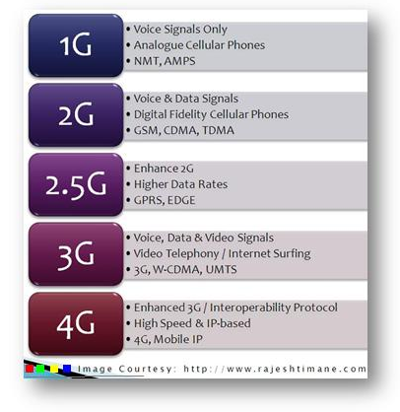
Various Generation of Network

Slide 88
1G: Analog Cellular Networks
The main technological development that distinguished the First Generation mobile phones from the previous generation was the use of multiple cell sites, and the ability to transfer calls from one site to the next as the user travelled between cells during a conversation. The first commercially automated cellular network (the 1G generations) was launched in Japan by NTT in 1979. In 1984, Bell Labs developed modern commercial cellular technology, which employed multiple, centrally controlled base stations (cell sites), each providing service to a small area (a cell). The cell sites would be set up such that cells partially overlapped. In a cellular system, a signal between a base station (cell site) and a terminal (phone) only need be strong enough to reach between the two, so the same channel can be used simultaneously for separate conversations in different cells. As the system expanded and neared capacity, the ability to reduce transmission power allowed new cells to be added, resulting in more, smaller cells and thus more capacity.

Slide 89
2G: Digital Networks
In the 1990s, the 'second generation' (2G) mobile phone systems emerged, primarily using theGSM standard. These 2G phone systems differed from the previous generation in their use of digital transmission instead of analog transmission, and also by the introduction of advanced and fast phone-to-network signaling. The rise in mobile phone usage as a result of 2G was explosive and this era also saw the advent of prepaid mobile phones. The second generation introduced a new variant to communication, as SMS text messaging became possible, initially on GSM networks and eventually on all digital networks. Soon SMS became the communication method of preference for the youth. Today in many advanced markets the general public prefers sending text messages to placing voice calls. Some benefits of 2G were Digital signals require consume less battery power, so it helps mobile batteries to last long. Digital coding improves the voice clarity and reduces noise in the line. Digital signals are considered environment friendly. Digital encryption has provided secrecy and safety to the data and voice calls. The use of 2G technology requires strong digital signals to help mobile phones work properly.

Slide 90
2.5G” using GPRS (General Packet Radio Service)
technology is a cellular wireless technology developed in between its predecessor, 2G, and its successor, 3G. GPRS could provide data rates from 56 kbit/s up to 115 kbit/s.
It can be used for services such as Wireless Application Protocol (WAP) access, Multimedia Messaging Service (MMS), and for Internet communication services such as email and World Wide Web access.

Slide 91
2.75 – EDGE
is an abbreviation for Enhanced Data rates for GSM Evolution.
EDGE technology is an extended version of GSM. It allows the clear and fast transmission of data and information up to 384kbit/s speed.

Slide 92
3G : High speed IP data networks
As the use of 2G phones became more widespread and people began to use mobile phones in their daily lives, it became clear that demand for data services (such as access to the internet) was growing. Furthermore, if the experience from fixed broadband services was anything to go by, there would also be a demand for ever greater data speeds. The 2G technology was nowhere near up to the job, so the industry began to work on the next generation of technology known as 3G. The main technological difference that distinguishes 3G technology from 2G technology is the use of packet switching rather than circuit switching for data transmission.

Slide 93
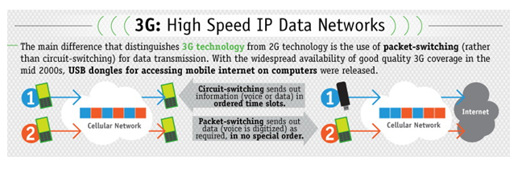

Slide 94
4G: Growth of mobile broadband
Consequently, the industry began looking to data-optimized 4th-generation technologies, with the promise of speed improvements up to 10-fold over existing 3G technologies. It is basically the extension in the 3G technology with more bandwidth and services offers in the 3G. The expectation for the 4G technology is basically the high quality audio/video streaming over end to end Internet Protocol.The first two commercially available technologies billed as 4G were the WiMAX standard and the LTE standard, first offered in Scandinavia by TeliaSonera. One of the main ways in which 4G differed technologically from 3G was in its elimination of circuit switching, instead employing an all-IP network. Thus, 4G ushered in a treatment of voice calls just like any other type of streaming audio media, utilizing packet switching overinternet, LAN or WAN networks via VoIP. 4G LTE data transfer speed can reach peak download 100 Mbit/s, peak upload 50 Mbit/s, WiMAX offers peak data rates of 128 Mbit/s downlink and 56 Mbit/s uplink.

Slide 95
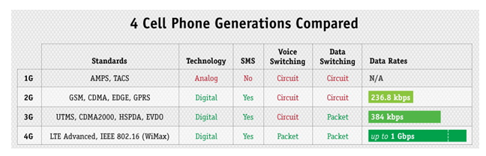

Slide 96
